Slide 1

Sound, Animation, and Video

Slide 2
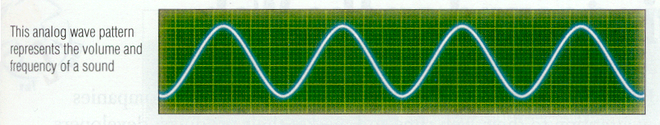
Sound
Analog wave patterns – these wave patterns have two attributes
  Volume – the height of each peak in the sound wave
  Frequency – (sometimes referred to as pitch) the distance between the peaks. The greater the distance, the lower the sound.
Image: scanned from Multimedia Concepts – James Schuman

Slide 3
Sampling
To include sound in a multimedia application, the sound waves must be converted from analog to digital form
This conversion is called sampling – every fraction of a second a sample the of sound is recorded in digital bits

Slide 4
Sampling
Two factors affect the quality of digitized sound
  Sample rate – the number of times the sample is taken
    Most common sampling rates are: 11.025, 22.05, and 44.1 kHz
  Sample size – the amount of information stored about the sample
    Most common sampling sizes are: 8 and 16 bit

Slide 5
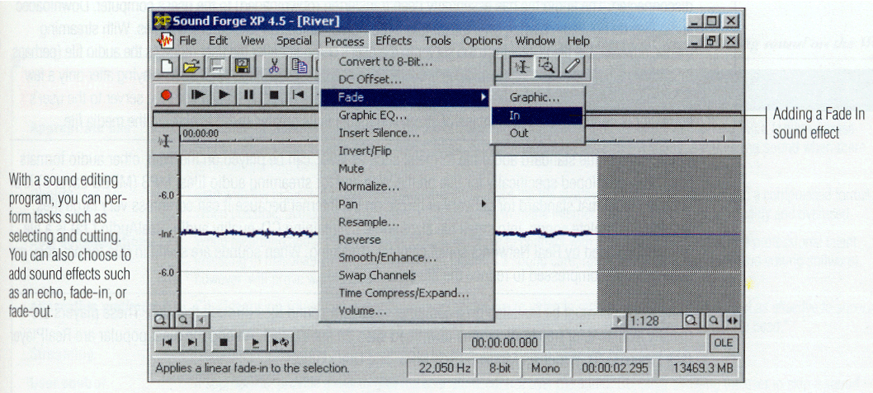
Sampling
Image: scanned from Multimedia Concepts – James Schuman

Slide 6

Sound File Formats
WAV format – filename.wav
AIFF (Audio Interchange File Format)
AIFFC (compressed)
RealAudio – filename.ra
MP3 (mpeg layer 3)

Slide 7

Sound on the Internet
Your first consideration when using sound on the Internet is file size
Uncompressed files can be very large
  A 10 second recording of an audio CD can be as large as 2MB

Slide 8
Sound Tips for the Internet
Appropriate Use | Consider the appropriateness of using sound. Some sounds are content-related, such as hearing a foreign phrase pronounced. Other sounds are for effect, such as creating a mood or setting a scene. Avoid using sound when there is no compelling benefit.
Quality | Start with the highest-quality sound available and reduce the file size by converting the audio file to a compressed format. When possible, avoid using free sound clips available from the Internet. These are often of poor quality and overused.
Cost considerations | When recording audio files, it may be cost-prohibitive to contract with a recording studio and hire professional talent. Investing in reasonably high-end equipment (such as a sound card, microphone, and recording and editing software), however, will prove worthwhile.

